Slide 1
PROFESSIONAL ETHICS AND CORPORATE GOVERNANCE Lecture: 2 Section 1 and Seminar 2

Slide 2
Evolution of the CFA Institute Code of Ethics and Standards of Professional Conduct
The Code and Standards must be regularly reviewed and updated if they are to remain effective and continue to represent the highest ethical standards in the global investment industry
Changes to the Code and Standards have far-reaching implications for the CFA Institute membership, the CFA Program, and the investment industry as a whole.
Code and Standards are increasingly being adopted, in whole or in part, by firms and regulatory authorities

Slide 3
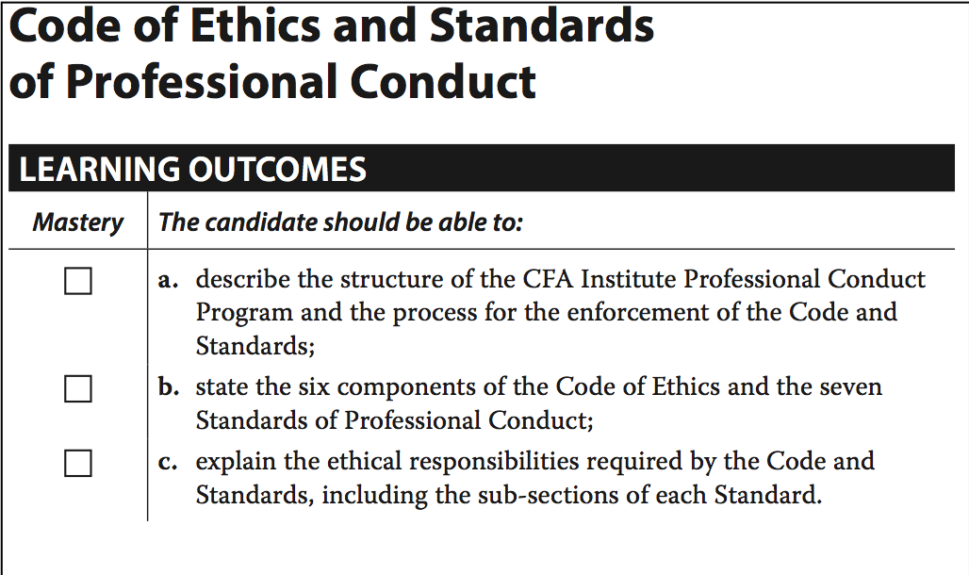
CFA Level 1: Reading 2

Slide 4
CFA Institute Mission
Mission:
To lead the investment profession globally by promoting the highest standards of ethics, education, and professional excellence for the ultimate bene t of society.
Old:
Promote the integrity of and uphold the rules governing capital markets.
New:
Promote the integrity and viability of the global capital markets for the ultimate bene t of society.

Slide 5
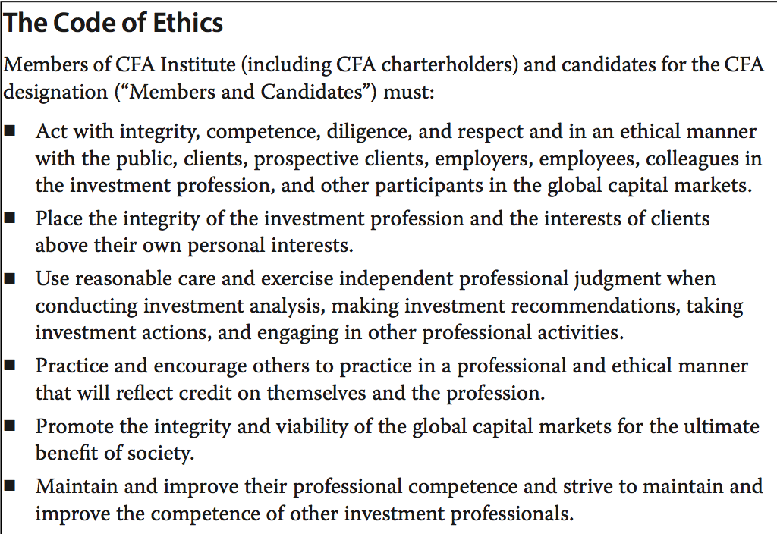

Slide 6
I. PROFESSIONALISM
A Knowledge of the Law
Members and Candidates must understand and comply with all applicable laws, rules, and regulations (including the CFA Institute Code of Ethics and Standards of Professional Conduct)
In the event of conflict, Members and Candidates must comply with the more strict law, rule, or regulation.
B Independence and Objectivity
Members and Candidates must use reasonable care and judgment to achieve and maintain independence and objectivity in their professional activities.

Slide 7
C Misrepresentation
Members and Candidates must not knowingly make any misrepresentations relating to investment analysis, recommendations, actions, or other professional activities.
D Misconduct
Members and Candidates must not engage in any professional conduct involving dishonesty, fraud, or deceit or commit any act that reflects adversely on their professional reputation, integrity, or competence.

Slide 8
II. INTEGRITY OF CAPITAL MARKETS
A Material (money, reputation, trade secrets) Nonpublic (confidential)
Members and Candidates who possess material nonpublic information that could affect the value of an investment must not act or cause others to act on the information.
B Market Manipulation
Members and Candidates must not engage in practices that distort prices or artificially in ate trading volume with the intent to mislead market participants.
--- using (fake or real) information & transactions
--- pump and dump

Slide 9
III. DUTIES TO CLIENTS
A Loyalty, Prudence, and Care
Members and Candidates have a duty of loyalty to their clients and must act with reasonable care and exercise prudent judgment. Members and Candidates must act for the bene t of their clients and place their clients’ interests before their employer’s or their own interests.
B Fair Dealing
Members and Candidates must deal fairly and objectively with all clients when providing investment analysis, making investment recommendations, taking investment action, or engaging in other professional activities.
C Suitability

Slide 10
The definition of ‘suitability’?
Reasonable judgement and recommendation
Suitable to client’s demand and need
The relevance of investments vs. portfolio
Consistency in investment and implementation of investing strategy

Slide 11
D Performance Presentation
When communicating investment performance information, Members and Candidates must make reasonable e orts to ensure that it is fair, accurate, and complete.
E Preservation of Confidentiality

Slide 12
IV. DUTIES TO EMPLOYERS
A Loyalty
B Additional Compensation Arrangements
C Responsibilities of Supervisors

Slide 13
V. INVESTMENT ANALYSIS, RECOMMENDATIONS, AND ACTIONS
A Diligence and Reasonable Basis
B Communication with Clients and Prospective Clients
C Record Retention

Slide 14
VI. CONFLICTS OF INTEREST
A Disclosure of Conflicts
B Priority of Transactions
C Referral Fees

Slide 15
VII. RESPONSIBILITIES AS A CFA INSTITUTE MEMBER OR CFA CANDIDATE
A Conduct as Participants in CFA Institute Programs
B Reference to CFA Institute, the CFA Designation, and the CFA Program

Slide 16
CFA Level 1: Reading 3 STANDARD I: PROFESSIONALISM
Standard I(A) Knowledge of the Law
Members and Candidates must understand and comply with all applicable laws, rules, and regulations (including the CFA Institute Code of Ethics and Standards of Professional Conduct) of any government, regulatory organization, licensing agency, or professional association governing their professional activities. In the event of conflict, Members and Candidates must comply with the more strict law, rule, or regulation. Members and Candidates must not knowingly participate or assist in an
Examples:

Slide 17
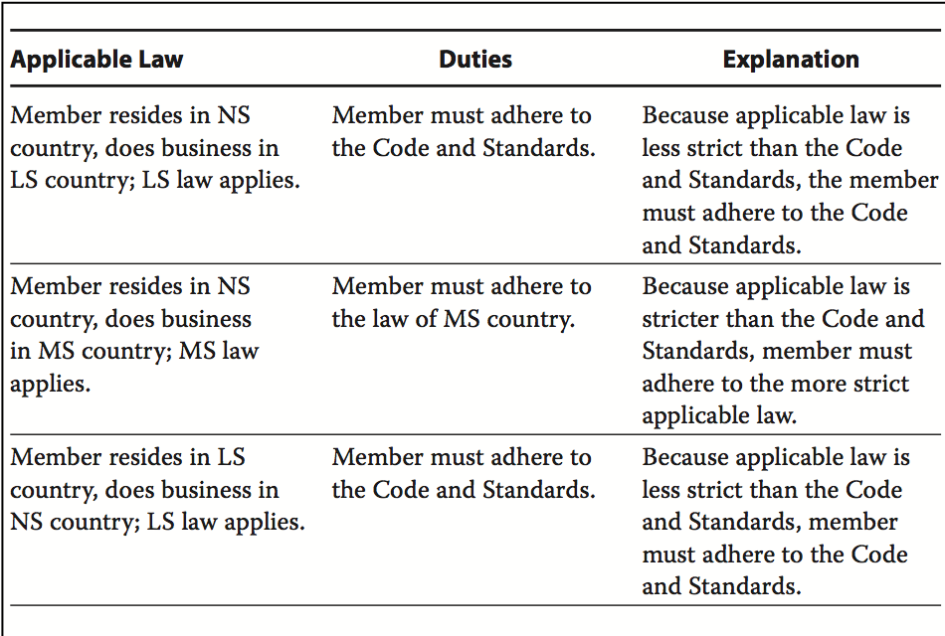

Slide 18
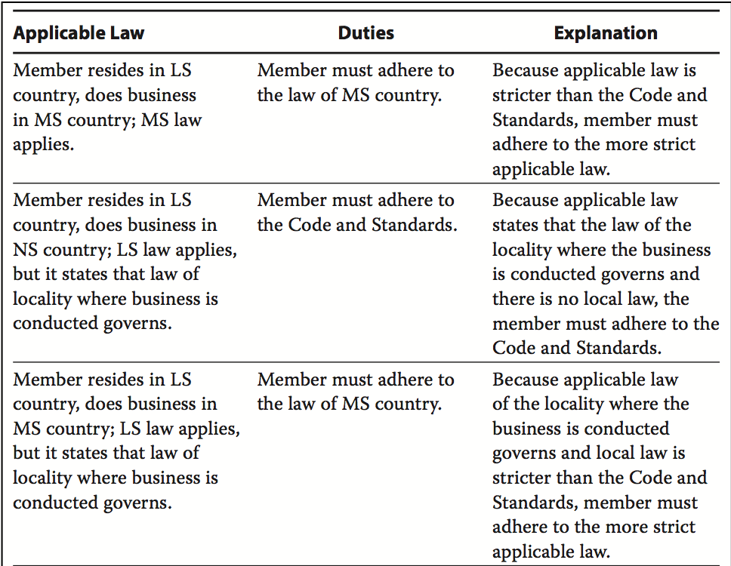

Slide 19
Recommended Procedures for Compliance
Stay informed
Review procedures
Maintain current les
Distribution Area Laws
Legal Counsel
Dissociation
Firms

Slide 20
Example: Notification of Known Violations:
Michael Allen works for a brokerage firm and is responsible for an underwriting of securities. A company official gives Allen information indicating that the financial statements Allen led with the regulator overstate the issuer’s earnings. Allen seeks the advice of the brokerage firm’s general counsel, who states that it would be difficult for the regulator to prove that Allen has been involved in any wrongdoing.

Slide 21
=>
Although it is recommended that members and candidates seek the advice of legal counsel, the reliance on such advice does not absolve a member or candidate from the requirement to comply with the law or regulation. Allen should report this situation to his supervisor, seek an independent legal opinion, and determine whether the regulator should be notified of the error.

Slide 22
CFA Level 1: Reading 3 STANDARD I: PROFESSIONALISM
Standard I(B) Independence and Objectivity
Members and Candidates must use reasonable care and judgment to achieve and maintain independence and objectivity in their professional activities. Members and Candidates must not offer, solicit, or accept any gift, bene t, compensation, or consideration that reasonably could be expected to compromise their own or another’s independence and objectivity.
Examples:

Slide 23
Discussions
Buy-Side Clients
Fund Manager and Custodial Relationships
Investment Banking Relationships
Performance Measurement and Attribution
Public Companies
Credit Rating Agency Opinions
Influence during the Manager Selection/Procurement Process
Issuer-Paid Research
Travel Funding

Slide 24
Recommended Procedures for Compliance
Protect the integrity of opinions
Create a restricted list
Restrict special cost arrangements
Limit gifts
Restrict investments
Review procedures
Independence policy
Appointed officer

Slide 25
Example: Research Independence and Sales Pressure
As support for the sales e ort of her corporate bond department, Lindsey Warner officers credit guidance to purchasers of fixed-income securities. Her compensation is closely linked to the performance of the corporate bond department. Near the quarter’s end, Warner’s firm has a large inventory position in the bonds of Milton, Ltd., and has been unable to sell the bonds because of Milton’s recent announcement of an operating problem. Salespeople have asked her to contact large clients to push the bonds.

Slide 26
=>
Unethical sales practices create significant potential violations of the Code and Standards. Warner’s opinion of the Milton bonds must not be affected by internal pressure or compensation. In this case, Warner must refuse to push the Milton bonds unless she is able to justify that the market price has already adjusted for the operating problem.

Slide 27
CFA Level 1: Reading 3 STANDARD I: PROFESSIONALISM
Standard I(C) Misrepresentation
Members and Candidates must not knowingly make any misrepresentations relating to investment analysis, recommendations, actions, or other professional activities
Examples:

Slide 28
Recommended Procedures for Compliance
Factual Presentations
Qualification Summary
Verify Outside Information
Maintain Webpages
Plagiarism Policy

Slide 29
Example: Correction of Unintentional Errors
Hijan Yao is responsible for the creation and distribution of the marketing materials for his firm, which claims compliance with the GIPS standards. Yao creates and dis- tributes a presentation of performance by the firm’s Asian equity composite that states the composite has ¥350 billion in assets. In fact, the composite has only ¥35 billion in assets, and the higher figure on the presentation is a result of a typographical error. Nevertheless, the erroneous material is distributed to a number of clients before Yao catches the mistake

Slide 30
=>
Once the error is discovered, Yao must take steps to cease distribution of the incorrect material and correct the error by informing those who have received the erroneous information. Because Yao did not knowingly make the misrepresentation, however, he did not violate Standard I(C). Because his firm claims compliance with the GIPS standards, it must also comply with the GIPS Guidance Statement on Error Correction in relation to the error.

Slide 31
CFA Level 1: Reading 3 STANDARD I: PROFESSIONALISM
Standard I(D) Misconduct
Members and Candidates must not engage in any professional conduct involving dis- honesty, fraud, or deceit or commit any act that reflects adversely on their professional reputation, integrity, or competence.
Examples:

Slide 32
Recommended Procedures for Compliance
Code of ethics
List of violations
Employee references

Slide 33
Example: Professional Misconduct
Meredith Rasmussen works on a buy-side trading desk of an investment management firm and concentrates on in-house trades for a hedge fund subsidiary managed by a team at the investment management firm. The hedge fund has been very successful and is marketed globally by the firm. From her experience as the trader for much of the activity of the fund, Rasmussen has become quite knowledgeable about the hedge fund’s strategy, tactics, and performance. When a distinct break in the market occurs and many of the securities involved in the hedge fund’s strategy decline markedly in value, Rasmussen observes that the reported performance of the hedge fund does not reflect this decline. In her experience, the lack of effect is a very unlikely occurrence. She approaches the head of trading about her concern and is told that she should not ask any questions and that the fund is big and successful and is not her concern. She is fairly sure something is not right, so she contacts the compliance officer, who also tells her to stay away from the issue of the hedge fund’s reporting.

Slide 34
=> Rasmussen has clearly come across an error in policies, procedures, and compliance practices within the firm’s operations. According to the firm’s procedures for reporting potentially unethical activity, she should pursue the issue by gathering some proof of her reason for doubt. Should all internal communications within the firm not satisfy her concerns, Rasmussen should consider reporting the potential unethical activity to the appropriate regulator.
See also Standard IV(A) for guidance on whistleblowing and Standard IV(C) for the duties of a supervisor.

Slide 35
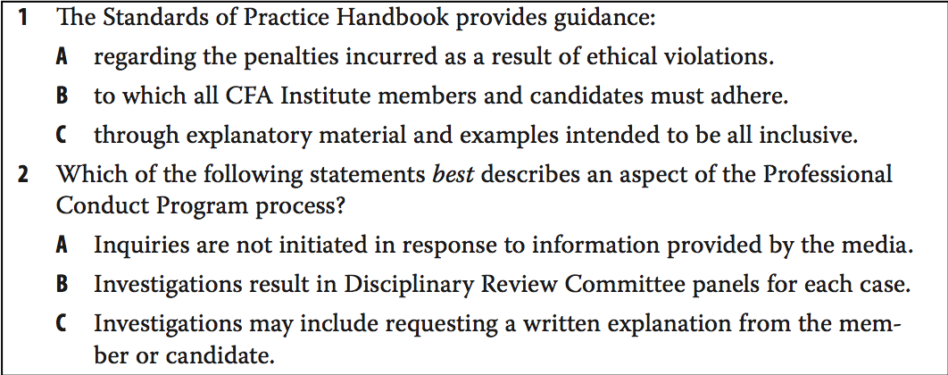
SEMINAR 2

Slide 36
Problem 1
B is correct. Standards of Practice Handbook provides guidance to which CFA Institute members and candidates are required to adhere.
A is incorrect because the Handbook provides guidance in understanding the interconnectedness of the aspirational and practical principles (not regarding penalties for violations) of the Code of Ethics and Standards of Conduct.
C is incorrect because although the Standards of Practice Handbook provides hypothetical but factual situations, the explanatory material and examples are not intended to be all inclusive.

Slide 37
Problem 2
C is correct. When an inquiry is initiated, the Professional Conduct sta con- ducts an investigation that may include requesting a written explanation from the member or candidate.
A is incorrect because Professional Conduct inquiries can be initiated in response to information provided by the media. CFA Institute sta may become aware of questionable conduct by a member or candidate through the media, regulatory notices, or another public source.
B is incorrect because although the Disciplinary Review Committee (DRC) is responsible for enforcement of the Code and Standards in conjunction with the Professional Conduct Program (PCP), only in the event that a member or candidate does not accept the charges and proposed sanction is the matter referred to a panel composed of DRC members.

Slide 38
Problem 3
According to the Duties to Clients standard, suitability requires members and candidates in an advisory relationship with a client to:
A place their clients’ interests before their own interests.
B consider investments in the context of the client’s total portfolio.
C not knowingly make misrepresentations relating to recommendations.

Slide 39
Problem 3
B is correct. Standard III.C.1c Suitability states that when members and candidates are in an advisory relationship with a client, they must judge the suitability of investments in the context of the client’s total portfolio.
A is incorrect because this is a requirement addressed under Standard III.A Loyalty, Prudence, and Care, not Standard III.C.1c Suitability.
C is incorrect because this is a requirement addressed under Standard I.C Misrepresentation, not Standard III.C.1c Suitability.

Slide 40
Problem 4
The Investment Analysis, Recommendations, and Actions standard states that members and candidates must:
A find an investment suitable for their client before making a recommendation.
B make reasonable efforts to ensure that performance presentation is fair, accurate, and complete.
C distinguish between fact and opinion in the presentation of investment analysis and recommendations.

Slide 41
Problem 4
C is correct. The V.B.4 Communications with Clients and Prospective Clients section of the Investment Analysis, Recommendations, and Actions standard states that members and candidates must distinguish between fact and opinion in the presentation of investment analysis and recommendations.
A is incorrect because this standard is discussed in the III.C.1b Suitability section of the Duties to Clients standard.
B is incorrect because performance presentation is discussed in the III.D Performance Presentation section of the Duties to Clients standard.

Slide 42
Problem 5
Laura Jameson works for a multinational investment adviser based in the United States. Jameson lives and works as a registered investment adviser in the tiny, but wealthy, island nation of Karramba. Karramba’s securities laws state that no investment adviser registered and working in that country can participate in initial public offerings (IPOs) for the adviser’s personal account. Jameson, believing that, as a US citizen working for a US-based company, she should comply only with US law, has ignored this Karrambian law. In addition, Jameson believes that as a charterholder, as long as she adheres to the Code and Standards requirement that she disclose her participation in any IPO to her employer and clients when such ownership creates a conflict of interest, she is meeting the highest ethical requirements.

Slide 43
=>
Jameson is in violation of Standard I(A). As a registered investment adviser in Karramba, Jameson is prevented by Karrambian securities law from participating in IPOs regardless of the law of her home country. In addition, because the law of the country where she is working is stricter than the Code and Standards, she must follow the stricter requirements of the local law rather than the requirements of the Code and Standards.

Slide 44
Problem 6 Fund Manager Relationships
Amie Scott is a performance analyst within her firm with responsibilities for analyzing the performance of external managers. While completing her quarterly analysis, Scott notices a change in one manager’s reported composite construction. The change concealed the bad performance of a particularly large account by placing that account into a new residual composite. This change allowed the manager to remain at the top of the list of manager performance. Scott knows her firm has a large allocation to this manager, and the fund’s manager is a close personal friend of the CEO. She needs to deliver her final report but is concerned with pointing out the composite change.

Slide 45
=>
Scott would be in violation of Standard I(B) if she did not disclose the change in her final report. The analysis of managers’ performance should not be influenced by personal relationships or the size of the allocation to the outside managers. By not including the change, Scott would not be providing an independent analysis of the performance metrics for her firm.

Slide 46
Problem 6 Information Misrepresentation
Khalouck Abdrabbo manages the investments of several high-net-worth individuals in the United States who are approaching retirement. Abdrabbo advises these individuals that a portion of their investments be moved from equity to bank-sponsored certificates of deposit and money market accounts so that the principal will be “guaranteed” up to a certain amount. e interest is not guaranteed.

Slide 47
=>
Although there is risk that the institution offering the certificates of deposits and money market accounts could go bankrupt, in the United States, these accounts are insured by the US government through the Federal Deposit Insurance Corporation. Therefore, using the term “guaranteed” in this context is not inappropriate as long as the amount is within the government-insured limit. Abdrabbo should explain these facts to the clients.

Slide 48
Problem 7 Professionalism and Competence
Simon Sasserman is a trust investment officer at a bank in a small affluent town. He enjoys lunching every day with friends at the country club, where his clients have observed him having numerous drinks. Back at work after lunch, he clearly is intoxicated while making investment decisions. His colleagues make a point of handling any business with Sasserman in the morning because they distrust his judgment after lunch.

Slide 49
=>
Sasserman’s excessive drinking at lunch and subsequent intoxication at work constitute a violation of Standard I(D) because this conduct has raised questions about his professionalism and competence. His behavior reflects poorly on him, his employer, and the investment industry.

Slide 50
Practice Problems at the end of the Reading 2 References:
Full list of reference: See Course Syllabus
Ethical and Professional Standards, and Quantitative Methods Book 1 CFA Program Curriculum CFA Exam level 1, CFA Institute (2020)
Ethical and Professional Standards, and Quantitative Methods Book 1 CFA Program Curriculum CFA Exam level 2, CFA Institute (2020)
Peck S.W (2011) Investment ethics, John Wiley and Sons, Inc.

